Slide 1
Mongo db
Group Members:
Muhammad Shoaib Akhter Qadri 02-131212-009
Haseebullah 02-131212-069

Slide 2
What is
MongoDB?

Slide 3
What is MongoDB?
A document-oriented, NoSQL database designed for scalability and high performance.
Key Characteristics:
JSON-like documents (BSON under the hood)
Flexible schema
High availability via replication
Horizontal scalability via sharding

Slide 4
Why MongoDB?

Slide 5
Why MongoDB?
Flexible Schema: Easy to adapt to changing application requirements
Scalability: Can scale out horizontally using sharding
Performance: Efficient for read/write operations at scale
Developer Friendly: JSON-like documents are intuitive for modern applications

Slide 6
NoSQL vs. RDBMS
Structure:
RDBMS: Table-based, fixed schema
NoSQL: Document/key-value/graph/column store, schema-less
Queries:
RDBMS: SQL-based
NoSQL: Varies by database type (MongoDB uses its own query language)

Slide 7

MongoDB Architecture
Mongodb: The primary database process (daemon)
Mongos: Router for sharded clusters
Config Servers: Holds metadata for sharding

Slide 8
MongoDB Architecture
Replication sets for high availability
Sharding for distributing data across multiple nodes

Slide 9
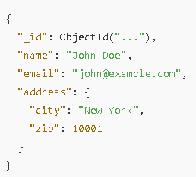
Databases, Collections & Documents
Database: Logical container for collections
Collection: Group of MongoDB documents (equivalent to a table in RDBMS)
Document: Basic unit of data in MongoDB (similar to a row in RDBMS), stored in BSON format

Slide 10
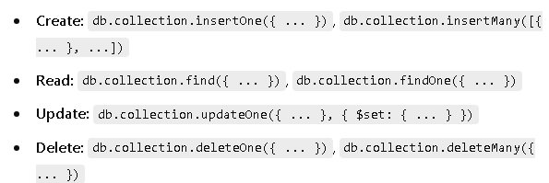
Basic CRUD Operations

Slide 11
Indexing
Purpose: Speed up queries by providing efficient data access paths
Types of Indexes:
Single Field
Compound (Multi-field)
Text
Geospatial

Slide 12
Indexing
Creation Syntax:
db.collection.createIndex({ fieldName: 1 });
Considerations:
Indexes consume RAM and storage
Too many indexes can slow down writes

Slide 13
Aggregation Framework
Definition: A powerful way to process data and perform transformations
Pipeline Stages: $match, $group, $project, $sort, $limit, $lookup
Example:
db.sales.aggregate([
{ $match: { status: "A" } },
{ $group: { _id: "$item", totalSales: { $sum: "$amount" } } }
]);

Slide 14
Replication
Replica Set: A group of mongod processes that maintain the same data set
Components:
Primary: Receives all write operations
Secondary: Copies data from primary; can serve read operations
Benefits:
High availability
Automatic failover

Slide 15
Sharding
Definition: Splitting data across multiple machines (shards) for horizontal scaling
Key Components:
Shard Servers (Data Nodes)
Config Servers (Metadata)
Mongos (Query Router)

Slide 16
Sharding
Shard Keys:
Determines how data is distributed. Choosing the right shard key is critical.
Benefits:
Supports massive data scaling and distribution

Slide 17
Security & Authentication
Authentication Methods:
SCRAM (default)
x.509 Certificates
LDAP / Kerberos (Enterprise features)
Role-Based Access Control:
Admin roles, database roles, user-defined roles
Network Security:
Enable firewall rules
Use TLS/SSL for encrypted communication

Slide 18
MongoDB Atlas
Overview:
Fully managed cloud database service by MongoDB
Key Features:
Automated backups
Global cluster distribution
Integrated monitoring and metrics
Autoscaling options

Slide 19
THANK YOU
Shoaib Akhter
Haseeb

